Slide 1
Azure Backup Labs Intro
Trainer

Slide 2
Operations Management Suite

Slide 3



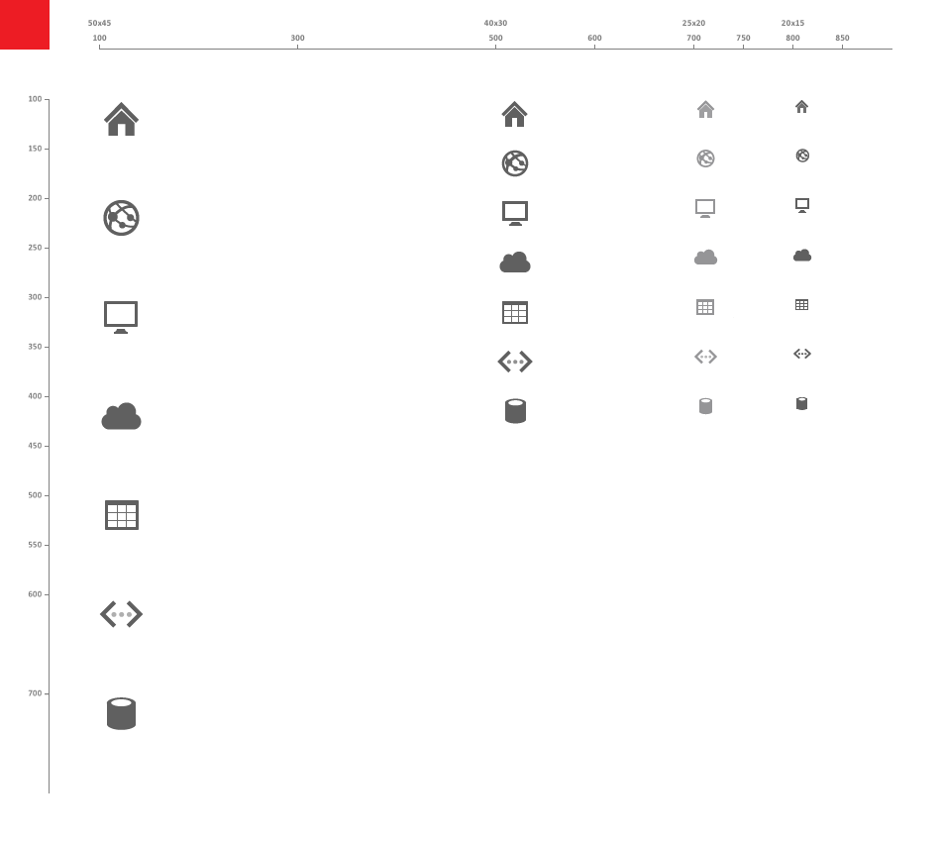
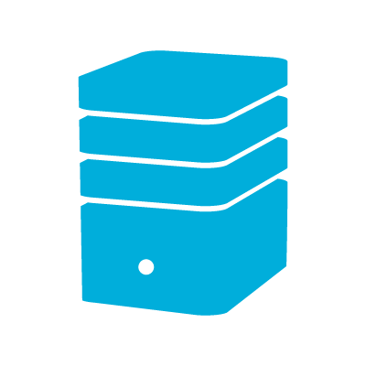










Operation Management Suite
Google
AWS
Log Analytics
Search, Correlate & Combine
Visualize Results
Centralized & Extensible Collection
Multiple Data Sources regardless of Volume, Format or Location
Ready Made Intelligence
Forecast Capacity
Assess System Update, Malware, Configuration
Change Tracking
Respond to Threats
Identify security breaches
Audit & Compliance
Azure VMs
Azure
Storage Diagnostics
Azure PaaS
Log Analytics Solutions:
Updates
Automation
Disaster recovery
Backup
WireData
Security & Audit
AD health
Service Map
3rd Party API
Search & Analytics
Microsoft Azure Log Analytics
Cloud
Azure Storage
Portal
Servers forwarding data through SCOM
Servers directly forwarding data
Windows & Linux Server
Windows & Linux Server
0365|AAD|SP|Exchange*
AVAILABILITY
REAL TIME
SEARCH
READY MADE INTELLIGENCE
DASHBOARDS
& REPORTING
SCALABLE
Automation
SECURITY
Notes:
Microsoft Operations Management Suite (OMS) is the all-in-one hybrid cloud management solution for any enterprise to manage their workloads and applications on Azure or AWS, Windows Server or Linux, VMware or OpenStack in the most cost-effective way.
The principle of OMS is collecting all the system data and perform intelligence on that.
Public Cloud offers this possibility. Huge amounts of data storage, fast searching and enormous scale. You can’t do this in your own data center.
Detect anomalies
Data entering OMS trough the OMS client is unstructured and being indexed on arrival.
This allows really fast search and supports various data formats.
If we look at traditional monitoring it’s depended of infrastructure of database and high-end storage. Therefor principle is to select which alert you want to receive and which ones not. It takes time to tune.
If not you will receive too many alerts but then you will miss crucial patterns.
Although traditional monitoring provides us a form of proactive operations it does not provide deep insights and troubleshooting is still a manual time consuming process.
With the cloud cadence companies miss the ability to manage multiple environments & platforms.

Slide 4


Operations Management Suite Capabilities
Log analytics
Backup & Recovery
IT Automation
Security & Compliance
Effortless log collection
Integrated fast search and queries with custom dashboard
Integrated cloud backup
Seamless disaster recovery and workload migration
Hybrid runbook worker
Graphical workbook authoring and automation DSC
Malware assessment
Security posture and system update assessment
With OMS capabilities customers can…
Spot problems fast
Protect data easily
Automate tasks quick
Recognize threat early
extending System Center capabilities, as an all-in-one management solution!
Notes:
The foundation of OMS is 2 services, 1 log analytics (formerly known as operational insights) and the other one automation.
If you want to manage an environment you need the ability get insight and visibility of what’s going on. With that insight you can make decisions. And with decisions you want to take action. And that’s where automation comes in.
So see, act, manage

Slide 5
System Center Advisor
Operational Insights
[OMS] Log analytics

Slide 6
Azure Backup

Slide 7
Disaster recovery and backup
Your customers need both
Disaster Recovery When applications have a catastrophic failure, they can run in Azure or a secondary datacenter
Backup
When data is corrupted or lost, restore it to the original location or a new location

Slide 8
Cloud-first enterprise backup
Simple and reliable
Zero infrastructure on cloud
Enterprise grade SLA
Cost-effective
Optimized for long term
Pay-as-you-go storage
Secure and scalable
Delivered from Azure
Simplified management
Notes:
OMS: Backup is built ground up to be a cloud-first enterprise backup solution. As such it’s designed to be simple i.e., provide you 80% of the functionality you are used to at 20% cost and complexity of your current solution. It’s also designed to be reliable and durable backed by enterprise grade Azure SLAs.
Simple & Reliable:
Support for backups across your heterogeneous environment, all managed and stored in Azure
Simplified item level restore for most enterprise applications
Backed by enterprise grade SLAs.
Cost-effective
Extremely cost-effective for long term retention with the protected instance based billing.
OMS based management instance cost grows only linearly with apps and VMs.
Pay as you go for non-linear growth of backend data at cost.
Secure & Scalable:
Peace of mind with enterprise grade security and encryption: data never leaves your premises un-encrypted.
Make use of the infinite scale of Azure to backup all your assets and eliminate your offsite.
Setup for next slide:
OMS: Backup achieves this by taking a fresh look at the data protection domain and wondering “what would a cloud-first data protection for modern enterprise look like?”

Slide 9
Azure Backup: A Quick Summary
Cloud Backup Solution
Cloud-first backup service running in Azure
Supports Azure IaaS VM, Windows Client, Server file/folder, VMs (Linux & Windows), SQL Server, Exchange, SharePoint
Integrates with SCDPM
Flexible long term retention policy
Granular recovery

Slide 10
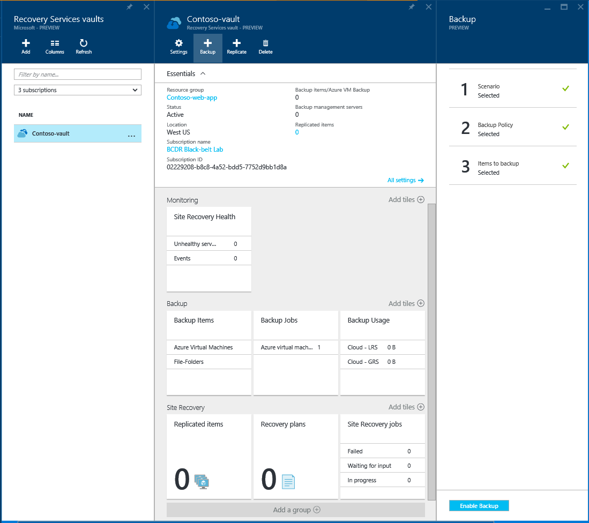
Simple management
Choose your scenario
Enterprise apps & remote apps
Azure IaaS VMs
Choose the retention
Cloud offsite with 99+ years
Enterprise grade policies
Enable backup!
Operational recovery on disk
Compliance and offsite on cloud

Slide 11
Azure Backup Scenarios
On-Premises
Hybrid Backup
IaaS Backup
Enterprise Solution SCDPM
SMB Solution Azure Backup Server
Enterprise Solution SCDPM + Azure Backup
SMB Solution Azure Backup Server Azure Backup Agent
Enterprise & SMB Azure IaaS VM Backup

Slide 12

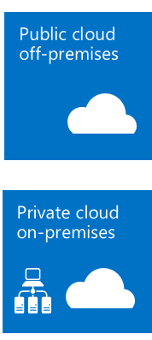


Infrastructure Admin
Application Admin
Freedom from Infrastructure
IaaS
PaaS
SaaS
Cloud Economics
Infinite Scale
Servers
Workloads
Clients
Pay-As-You-Go
Hybrid IT
Cloud Promises

Slide 13
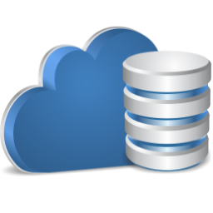

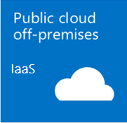

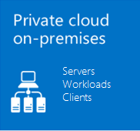

Infrastructure Admin
Application Admin
Cloud as Infrastructure
(IaaS)
Freedom from Infrastructure
Pay-as-you-go
Software licensing costs
Cost effectiveness
Storage egress charges
Cloud Economics
Infinite Scale
Cloud as Storage
Pay-as-you-go Storage
Software licensing costs
On-premises infrastructure
Storage egress charges
Pay-As-You-Go
Hybrid IT
Cloud Promises
Traditional Backup

Slide 14


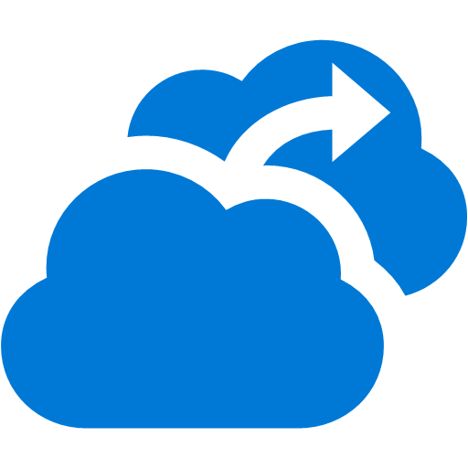

Infrastructure Admin
Application Admin
Cloud as Infrastructure
(IaaS)
Azure Backup
Beyond Backup
Freedom from Infrastructure
IaaS
PaaS
SaaS
Pay-as-you-go
Software licensing costs
Cost effectiveness
Storage egress charges
Azure Site Recovery
Azure Backup
Azure
Cloud as a Platform
Data Services
Auth Services
Cloud Economics
First-class integration with Azure services
Rich monitoring
Insights and Analytics
Leverage Azure identity and security services
Pay-as-you-go
No infrastructure for Backup
No Storage egress charges
Single management pane
Self-service
Servers
Workloads
Clients
Infinite Scale
Cloud as Storage
Pay-as-you-go Storage
Software licensing costs
On-premises infrastructure
Storage egress charges
Pay-As-You-Go
Hybrid IT
Cloud Promises
Traditional Backup
Cloud-First Backup

Slide 15

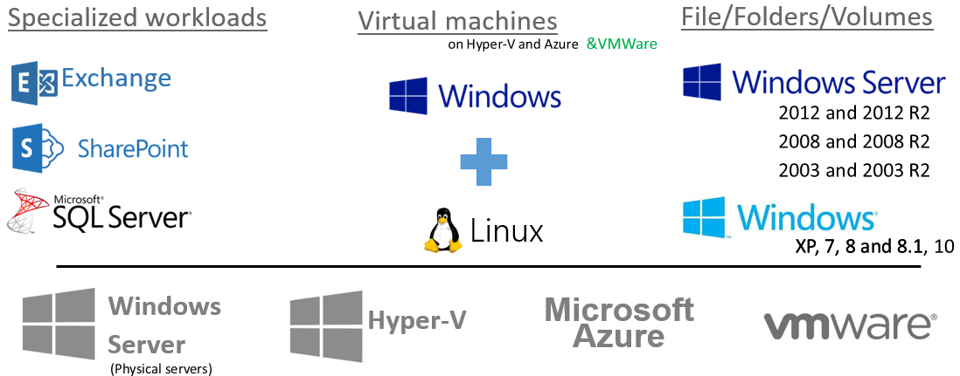
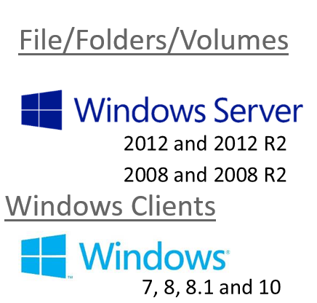
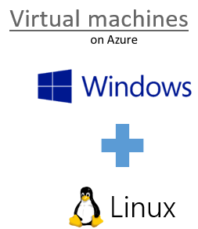
Azure Backup Architecture
Azure Cloud
DPM-A (D-D-C)
OMS Instances
DPM / Azure Backup Server
Azure Backup Service
CSP Enabled
OMS Instances
Azure Backup (D-C)
Azure IaaS VM Backup
OMS Instances
DPM / Azure Backup Server
OMS Instances
On premises – built & managed infrastructure
Cloud – flexible, remote infrastructure

Slide 16
Lab Overview

Slide 17

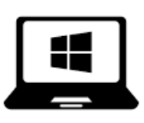
Azure Backup Lab Environment
Contoso.com
LinuxContoso
SPContoso-sp
Azure Backup
Your Laptop

Slide 18
Lab Outline
Azure Account
Deploy VMs
Recovery Vault creation
Backup/Restore of IaaS VMs on Azure
Backup/Restore of folder on your laptop
Backup/Restore using MABS or SC-DPM

Slide 19
Deployment Models (1 of 2)
 | Characteristics
SCDPM + Azure Backup | Disk to disk to cloud backup - Faster operational recovery from disk backups (D to D to C) Requires additional server and local disks Workload backup (File/Folder, SQL, Exchange, Sharepoint, Client, Hyper-V VM, VMWare VM) Only SCDPM server needs internet connectivity Flexible backup schedule Central Backup Policy Enforcement (backup policy or encryption keys) Licensing tied to System Center Requires Azure subscription only to backup to Azure
Microsoft Azure Backup Server | Works just like SCDPM + Azure Backup except: Requires Azure subscription always Pay as you go license - tied to Azure subscription (SQL License bundled with Azure backup server) Cost effective for SMB No tape backup support Note: Can perform disk to disk backup (or) disk to disk to cloud backup - sending backup data to Azure is optional

Slide 20
Deployment Models (2 of 2)
 | Characteristics
Microsoft Azure Backup Agent (MARS agent) | No on-prem storage (D to C) No additional infrastructure needed File/folder protection only (no other workloads) Windows Servers require internet connectivity Self Service Backup and Recovery Max backups can be thrice a day and single backup policy per server No central enforcement of encryption keys or policy
Azure IaaS Backup | Cloud to cloud backup VM level backup (Windows and Linux) Need to enable protection on the IaaS VM

Slide 21
Resources
Azure Backup landing page: http://azure.microsoft.com/en-us/services/backup/
Azure Backup documentation: https://azure.microsoft.com/en-us/documentation/services/backup/
Azure Backup videos: https://channel9.msdn.com/Series/Azure-Backup
Azure Backup blogs: http://blog.azure.com/tag/azure-backup/
Azure Backup Template Deployment
Hybrid Backup eBook: http://aka.ms/HybridBackupEBook
Calculator https://doc.co/SXuiaN
MVA course on Azure Backup

